Slide 1
ASP.NET CORE WEB API

Slide 2
API
Before we understand what is Web API, let's see what is an API (Application Programing Interface).
As per Wikipedia's Definition of API: In computer programming, (API) is a set of subroutine definitions, protocols, and tools for building software and applications.

Slide 3
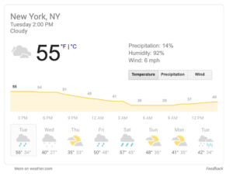
Some Examples of APIs
Weather Snippets

Slide 4
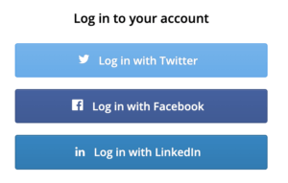
Some Examples of APIs
Log-in Using XYZ

Slide 5
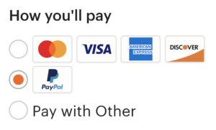
Some Examples of APIs
Pay with PayPal

Slide 6
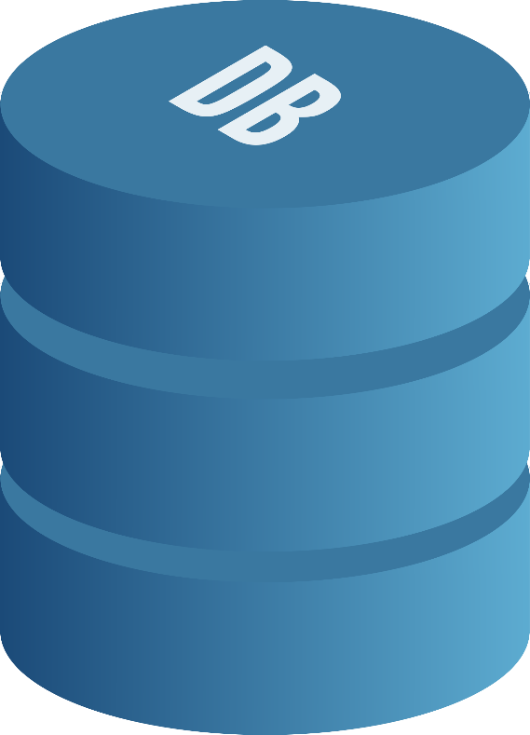
GET
POST
PUT
DELETE
HTTP PROTOCOL
MOBILE APPLICATIONS
VERBS
XML
WEB API
JSON
DESKTOP APPLICATIONS
BROWSERS
REST
IOTs
Architectural style or pattern

Slide 7
DESKTOP APPLICATIONS
MOBILE APPLICATIONS
OVERALL CASES
WEB API
Related to Corona Virus
NEW CASES
DEATHS
RECOVER
BROWSERS

Slide 8
DESKTOP APPLICATIONS
MOBILE APPLICATIONS
STUDENTS INFO
WEB API
Related to a SCHOOL
ATTENDANCE
RESULTS
ADDMISSIONS
BROWSERS

Slide 9
ASP.NET CORE WEB API
Web API allows users to access a particular resource using HTTP protocol.
We can build Web API using different technologies like .NET, PHP, JAVA, PYTHON etc
In .Net Microsoft has created a framework for web API called ASP.NET WEB API.
ASP.NET Web API is a framework that makes it easy to build HTTP web services (Restful HTTP services).

Slide 10
ASP.NET CORE WEB API
It is provided by Dot Net Framework.
That web services reaches a broad range of clients, including browser, mobile applications, Desktop application and IOTs.
It is very similar to ASP.NET MVC since it contains the MVC features.

Slide 11
ASP.NET CORE WEB API
Web API is a programming interface/application type that provides communication or interaction between software applications.
Web API is often used to provide an interface for web sites and client applications to have data access.
Web APIs can be used to access data from a database and save data back to the database.

Slide 12
What is Restful Services
Rest Stands for “Representational state transfer”.
Its introduce in 2000 by Roy Fielding.
In REST architecture, a REST Server simply provides access to resources and the REST client accesses and presents the resources.
Here each resource is identified by URIs/ Global IDs.

Slide 13
What is Restful Services
A resource is any information that has name like image, entity, document etc.
REST uses various representations to represent a resource like Text, JSON and XML. JSON is now the most popular format being used in Web Services.

Slide 14
What is Restful Services
REST architectural pattern specifies a set of constraints that a system adhere to.
Client Server
Stateless
Cacheable
Uniform Interface

Slide 15
What is Restful Services
RESOURCE
VERB
RESULT
/Students
GET
Gets list of students
/Students/1
GET
Gets student with id = 1
/Students
POST
Creates a new student
/Students/1
PUT
Updates student with id = 1
/Students/1
DELETE
Deletes student with id = 1

